Slide 1
SS ZG653: Software Architecture Lecture 16: Review Session
Instructor: Prof. Santonu Sarkar
April 7, 2015

Slide 2
What is a Pattern
Describes a particular recurring design problem that arises in specific design contexts
and represents a well-proven generic scheme for its solution.
The solution scheme is specified by describing its constituent components, their responsibilities and relationships, and the ways in which they collaborate
Buschmann, F. et al, Pattern Oriented Software Architecture – Volume1, Wiley, 1996

Slide 3
Pattern – Three-part Schema
Pattern
Context A situation giving rise to a problem
Problem The recurring problem arising in that context
Solution A proven solution of the problem

Slide 4
Patterns – Three Categories
Category | Description
Architectural | Fundamental structural organization schema of software systems. It provides a set of predefined subsystems, specifies their relationships, and includes rules and guidelines for organizing the relationships between them.
Design | A scheme for refining the subsystems or components of a software system, or the relationships between them. It describes a commonly-recurring structure of communicating components that solves a general design problem within a particular context.
Idiom | An idiom is a low-level pattern specific to a programming language. An idiom describes how to implement particular aspects of components or the relationship between them using features of the given language

Slide 5
Architectural Patterns
Layers
Pipes and Filters
Blackboard
Mud to Structure
Broker
Distributed Systems
Model-View-Controller
Interactive Systems
Microkernel
Reflection
Adaptive Systems

Slide 6
Layers Quick Reference
Pattern | Description
Context | A large system that requires decomposition
Problem | Mix of low- and high-level issues, where high-level operations rely on low-level ones A typical pattern of communication flow consists of requests moving from high level to low level, and answers to requests, incoming data and notification about events traveling in the opposite direction Forces Code changes should not ripple through the system Stable interfaces; standardisation Exchangeable parts Grouping of responsibilities for better understandability and maintainability
Solution | Structure the system into appropriate number of layers
Variants | Relaxed Layered System Layering Through Inheritance
Benefits | Reuse of layers Support for standardisation Dependencies are kept local Exchangeability
Liabilities | Cascades of changing behaviour Lower efficiency Unnecessary work Difficulty in establishing the correct granularity
Layer N
Layer N
Layer N-1
Layer N-1
Define the abstraction criteria
Layer 1
Layer 1
Determine the numbers of layers based on abstraction criteria
Specify the communication between adjacent layers
Name the layers and assign tasks to each of them
Specify the services
Decouple adjacent layers
Iterate and refine
Design error handling strategy
Specify an interface for each layer
Structure individual layers

Slide 7
Layers
Pattern | Description
Context | A large system that requires decomposition
Problem | Mix of low- and high-level issues, where high-level operations rely on low-level ones A typical pattern of communication flow consists of requests moving from high level to low level, and answers to requests, incoming data and notification about events traveling in the opposite direction Forces Code changes should not ripple through the system Stable interfaces; standardization Exchangeable parts Grouping of responsibilities for better understandability and maintainability
Solution | Structure the system into appropriate number of layers
Variants | Relaxed Layered System Layering Through Inheritance
Benefits | Reuse of layers Support for standardization Dependencies are kept local Exchangeability
Liabilities | Cascades of changing behavior Lower efficiency Unnecessary work Difficulty in establishing the correct granularity

Slide 8
Pipes and Filters
Context | Processing Data Streams
Problem | System that must process or transform a stream of input data. Multi-stage operations on data (workflow) Many developers may work on different stages Requirements may change
Forces | Future enhancements – exchange processing steps or recombination Reuse desired, hence small processing steps Non adjacent processing steps do not share information Different sources of data exist (different sensor data) Store final result in various ways Explicit storage of intermediate results should be automatically done Multiprocessing the steps should be possible
Solution | Pipes and filters – data source to data sink

Slide 9
Scenarios
Push pipeline
Pull pipeline
Multiprocess
Everyone actively pulls, and then push

Slide 10
Benefits and Libabilities
Benefits
Liabilities
No intermediate files necessary, but possible
Filter addition, replacement, and Reuse
Possible to hook any two filters together
Rapid prototyping of pipelines
Concurrent execution
Certain analysis possible
Throughput, latency, deadlock
Sharing state information is expensive or inflexible
Data transformation overhead
Error handling can be a problem
Does not work well with interactive applications
Lowest common denominator on data transmission determines the overall throughput

Slide 11
Blackboard Architecture
A set of heterogeneous specialized modules which dynamically change their strategies as a response to unpredictable events
Non-deterministic strategies
Problem
no deterministic solutions to process raw data
Required to interchange algorithms processing some intermediate computation
No predetermined strategy, and dealing with uncertain knowledge
Forces
The solution space is too large to search
Different algorithms to be used for partial solutions
One algorithm uses results of another algorithm
Input, intermediate data, output can have different representation
No strict sequence between algorithms

Slide 12
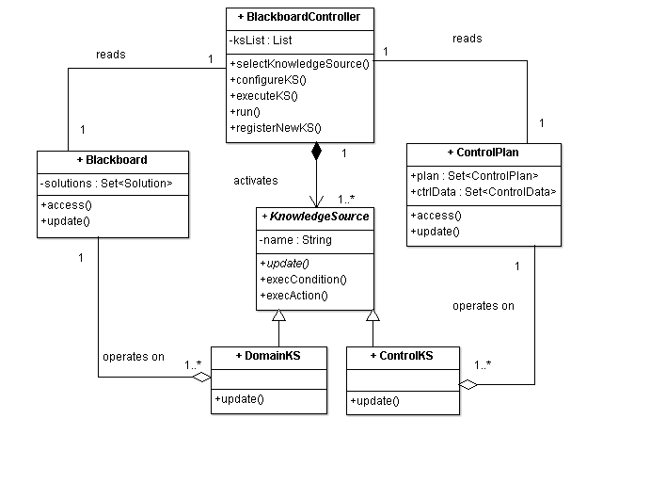
Solution Structure
Runs in a loop
Monitors change in blackboard
Activates next KS
Selection strategy may depend on ControlData
Highly specialized modules
Each is different
Has a set of triggering conditions
Executable code that retrieves data from the blackboard and updates blackboard
Don’t interact with each other
Updates control Data
Such as:
progress estimation,
computation cost to execute a KS
Control plan
Shared datastore containing partial solutions

Slide 13
Benefits and Liabilities
Benefits
Liabilities
Experimentation- try with different strategies,
Support for modifiability- each KS is strictly decoupled
Reuse of KS
Fault-tolerance even when the data is noisy
Difficulty in testing
No good solution guaranteed
Computational overhead in rejecting wrong solutions
High development effort
Concurrent access to blackboard must be synchronized, parallelization is difficult

Slide 14
Broker Pattern
Context
To take advantage of computing power of many CPUs
A software may be available only on a specific computer
Due to security reasons, different parts runs in different systems
Some services are provided by business partners over the internet
Forces
It should be possible to distribute components during deployment– application should unaware of collocation or location
Need to exchange, add, or remove components at run-time
Should hide system specific details from users of components and services

Slide 15
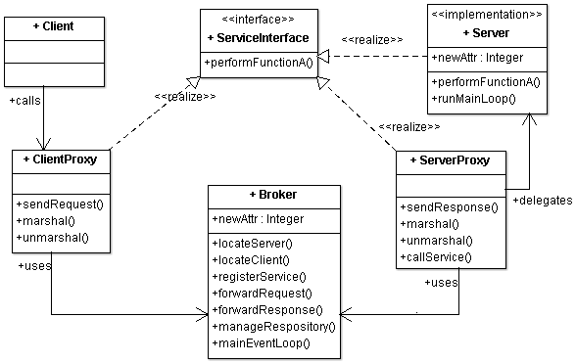
Broker
Necessary abstraction that makes distribution possible by providing the contract about the service that the server is going to provide without exposing the implementation details on the server side
Process 1
Process 2
Process 3

Slide 16
Benefits and Liabilities
Benefits
Liabilities
Location Independence
Type System Transparency— Differences in type systems are coped with by a intermediate network protocol
Isolation-- Separating all the communication-related code into its own layer
Separation of Concerns —The communication and marshaling concerns are encapsulated in the requestor, invoker, and marshaler.
Resource Management—seperated from the application logic.
Portability
Error Handling—To cope with the unreliability of network communication.
Performance
Lower fault tolerance (server fails, broker fails, ...)
Testing and debugging

Slide 17
Model-View-Controller
Pattern | Description
Context | Interactive applications with a flexible human-computer interface
Problem | User interface are prone to change requests Extend the functionality of an application, modification of menus is a must Specific customisation may be requested by the customer
Solution | Divide the entire application into Processing, Output and Input (Model, View and Controller) Model: Encapsulates core data and functionality, independent of specific output representations or input behaviour View: Displays information to the user obtained from the model, multiple views possible Controller: Receives input events which are translated to service requests from the model or the view
Variants | Document-View and many
Benefits | Multiple views of the same model Synchorised views ‘Pluggable’ views and controllers Exchangeability of ‘look-and-feel’ Framework potential
Liabilities | Increased complexity Potential for excessive number of updates Intimation connection between view and controller Close coupling of views and controllers to a model Inefficiency of data access in view Inevitability of change to view and controller when porting Difficulty of using MVC with modern user-interface tools

Slide 18
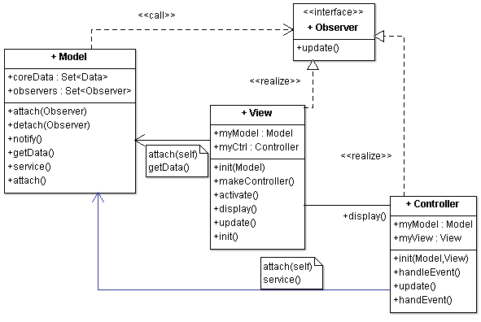
MVC Quick Reference
User makes change in UI, which comes to controller
Controller interprets the change, informs model for the change
Model makes change in data
Model notifies all the relevant views regarding the change
View gets latest data and updates the display
 | # | Steps
Fundamental steps for realising a MVC | 1 | Separate human-computer interaction from the core functionality
 | 2 | Implement the change propagation mechanism
 | 3 | Design and implement views
 | 4 | Design and implement controllers
 | 5 | Design and implement the view-controller relationship
 | 6 | Implement the set-up of MVC
Additional Scenarios | 7 | Update to display alone i.e. no change in the controller
 | 8 | Pluggable Controllers
 | 9 | System exit. Sequence of deletion or destruction of objects
 | 10 | Scenario of update with multiple View-Controller pairs
Pattern | Description
Context | Interactive applications with a flexible human-computer interface
Problem | User interface are prone to change requests Extend the functionality of an application, modification of menus is a must Specific customisation may be requested by the customer
Solution | Divide the entire application into Processing, Output and Input (Model, View and Controller) Model: Encapsulates core data and functionality, independent of specific output representations or input behaviour View: Displays information to the user obtained from the model, multiple views possible Controller: Receives input events which are translated to service requests from the model or the view
Variants | Document-View and many
Benefits | Multiple views of the same model Synchorised views ‘Pluggable’ views and controllers Exchangeability of ‘look-and-feel’ Framework potential
Liabilities | Increased complexity Potential for excessive number of updates Intimation connection between view and controller Close coupling of views and controllers to a model Inefficiency of data access in view Inevitability of change to view and controller when porting Difficulty of using MVC with modern user-interface tools

Slide 19
Microkernel
Pattern | Description
Context | The development of several applications that use similar programming interfaces that build on the same core functionality
Problem | Developing software for an application domain that needs to cope with a broad spectrum of similar standards and technologies Continuous evolution (software and hardware), platform must be extensible, portable and adaptable
Solution | Encapsulate the fundamental services of your application platform in a microkernel component Microkernel includes functionality that enables other components running in separate processes to communicate to each other; maintain system resources Internal servers, external servers, adapters, clients, microkernel
Variants | Microkernel System with indirect Client-Server connections Distributed Microkernel System
Benefits | Portability Flexibility and Extensibility Separation of policy and mechanism Scalability Reliability Transparency
Liabilities | Performance Complexity of design and implementation

Slide 20
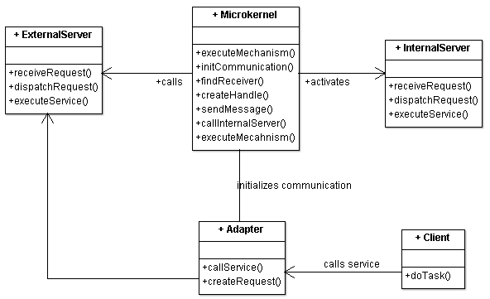
Microkernel Quick Reference
# | Steps
1 | Analyse the application domain
2 | Analyse the external servers
3 | Categorise the servers
4 | Partition the categories
5 | Find a consistent and complete set of operations and abstractions
6 | Determine strategies for request transmission and retrieval
7 | Structure the microkernel component
8 | Specify the programming interfaces for the microkernel
9 | Microkernel is responsible for all the system resources
10 | Design and implement the internal servers
11 | Implement the external servers
12 | Implement the adapters
13 | Develop client applications
Pattern | Description
Context | The development of several applications that use similar programming interfaces that build on the same core functionality
Problem | Developing software for an application domain that needs to cope with a broad spectrum of similar standards and technologies Continuous evolution (software and hardware), platform must be extensible, portable and adaptable
Solution | Encapsulate the fundamental services of your application platform in a microkernel component Microkernel includes functionality that enables other components running in separate processes to communicate to each other; maintain system resources Internal servers, external servers, adapters, clients, microkernel
Variants | Microkernel System with indirect Client-Server connections Distributed Microkernel System
Benefits | Portability Flexibility and Extensibility Separation of policy and mechanism Scalability Reliability Transparency
Liabilities | Performance Complexity of design and implementation

Slide 21
Reflection Quick Reference
# | Steps
1 | Analyse the application domain
2 | Analyse the external servers
3 | Categorise the servers
4 | Partition the categories
5 | Find a consistent and complete set of operations and abstractions
6 | Determine strategies for request transmission and retrieval
7 | Structure the microkernel component
8 | Specify the programming interfaces for the microkernel
9 | Microkernel is responsible for all the system resources
10 | Design and implement the internal servers
11 | Implement the external servers
12 | Implement the adapters
13 | Develop client applications
Pattern | Description
Context | Support for variation and change in the structure of the system Create architecture that’s open to change
Problem | How to build systems that support unanticipated changes?
Solution | Encapsulate information about properties and variant aspects of the application’s structure, behavior, and state into a set of meta-objects. Separate the meta-objects from the core application logic via a two-layer architecture: The meta level contains the meta-objects The base level contains the application logic. Base-level objects consult an appropriate meta-object before they execute behavior or access state that potentially can vary
Examples | Java offers Reflection through capabilities provided in the Java Reflection API Broker Pattern – CORBA and RMI offers Reflection in terms of its Dynamic Invocation Interface (DII) and Interface Repository RMI
Benefits | Flexibility and Extensibility
Liabilities | Poor Performance Since reflection resolve the types dynamically, it involves extra processing like scanning to find the class to load and introspect, causing slow performance. Security Restrictions Reflection requires runtime permissions that might not be available for system running under security manager. This can cause you application to fail at runtime because of security manager. Security Issues Using reflection we can access part of code that we are not supposed to access, for example we can access private fields of a class and change it’s value. This can be a serious security threat and cause your application to behave abnormally. High Maintenance Reflection code is hard to understand and debug, also any issues with the code can’t be found at compile time because the classes might not be available, making it less flexible and hard to maintain.

Slide 22
Design Pattern

Slide 23
From GoF classification
Creational | Factory Pattern | About creation
 | Factory Method | About creation, also called Idioms
 | Singleton
Structural | Adapter | About structural decomposition
 | Composite
 | Decorator | About service extension
 | Proxy | About access control
Behavioral | Iterator
 | Observer | Communication
 | Visitor | About service extension
 | Strategy | Service variation
 | Command | Organization of task

Slide 24
Creational - Two similar patterns
Factory Method
Abstract Factory
The creator (abstract class) creates objects of another type (the product)
Knows when to create but does not anticipate what type of product to create
Subclasses of the creator type knows what type of product to create
Clients do not need to know the exact type of product it is getting
Provide an interface for creating families of related or dependent objects without specifying their concrete classes
One more level of abstraction. The client does not even know what factory it's going to use. First, it gets a Factory and then it calls a Factory method

Slide 25
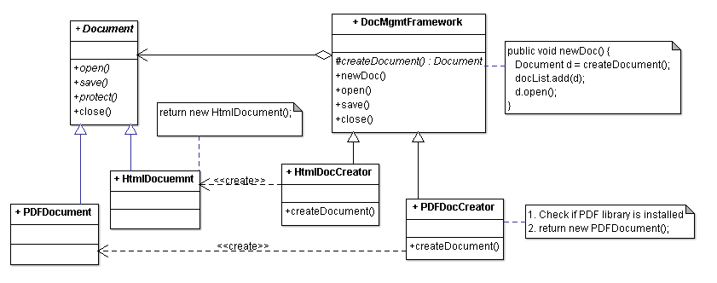
Factory Method Pattern
DocumentMgmtFramework
knows when to create a Document (when user selects the menu item
but DOES NOT anticipate what type of Document to create

Slide 26
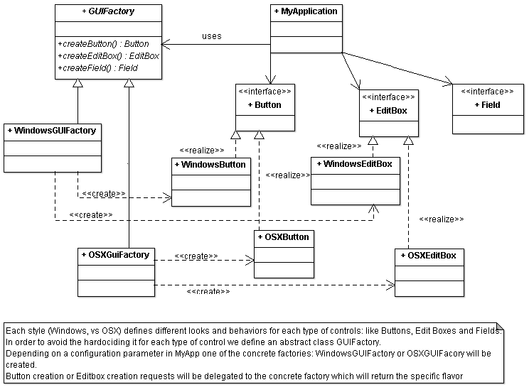
Abstract Factory Pattern

Slide 27
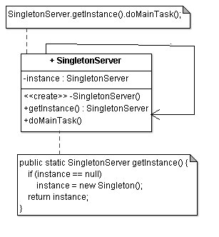
Singleton Pattern
A static member in the Singleton class
A private constructor
The constructor should not be accessible from the outside of the class to ensure the only way of instantiating the class would be only through getInstance()
A static public method that returns a reference to the static member
getInstance() method is used also to provide a global point of access to the object

Slide 28
Structural Patterns
A set of design patterns that provides easy and generalized techniques to realize relationships between entities
Decorator pattern
A component need to be enhanced (a window to have a scrollbar) or additional responsibilities to be added
The decorated object can be used in the same way as the undecorated object
Adapter pattern
Like any adapter in the real world, it is a bridge between two objects
One class expecting some type of object and you have an object offering the same features, but exposing a different interface
Composite pattern
Composite Objects are collection objects which can contain other objects (primitive or composite)
Interface for operation (whether for primitive type or composite type) is same
Any operation for primitive type object is atomic in nature but the same operation for a composite type object is recursive in nature
Proxy pattern
We need the ability to control the access to an object
For example if we need to use only a few methods of some costly objects we'll initialize those objects when we need them entirely.
Till that situation arises, we can use some light objects exposing the same interface as the heavy objects. They will instantiate those heavy objects when they are really need
Different access rights to an object
Providing a sophisticated means of accessing and referencing objects running in other processes, on other machines.

Slide 29
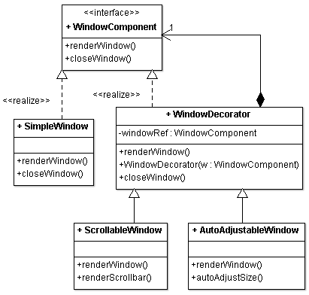
Decorator Pattern Class Diagram
Define an interface that is an abstraction for the component
Concrete component classes realize this interface type
Decorator classes also realize this interface type
Decorator object manages the component object that it decorates
When implementing a method from the component interface type, the decorator class applies the method to the decorated component
Combines the result with the effect of the decoration

Slide 30
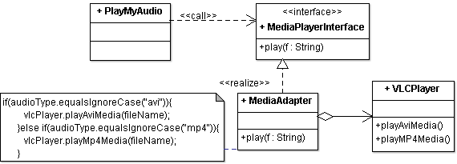
Adapter pattern class diagram
Define an adapter class that implements the Target interface
Adapter lets classes work together, that could not otherwise because of incompatible interfaces
The adapter class holds a reference to the Adaptee. It translates target methods to Adaptee methods.
Adaptee is wrapped into an adapter class object
Composition plays an important role
Target
Adaptee

Slide 31
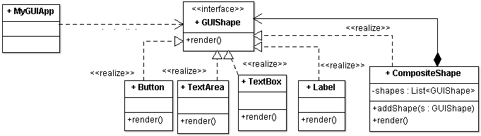
Composite Pattern Class Diagram
STEP 1: Create an interface for Common Operations
STEP 2: Both Primitive and Composite Objects Realize the same interface
STEP 3: Make Composite Objects as a collection of primitive objects

Slide 32
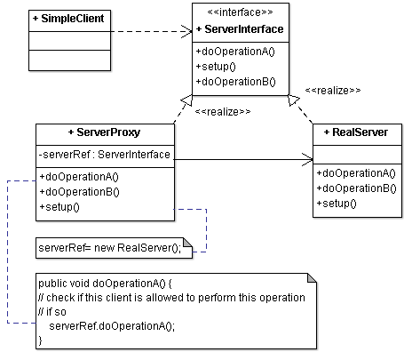
Proxy Class Diagram
A client obtains a reference to a Proxy, the client then handles the proxy in the same way it handles RealSubject and thus invoking the method doOpeationA().
This interface is implemented by both Real subject and proxy
Maintains a reference that allows the Proxy to access the RealSubject.
Implements the same interface implemented by the Real Subject so that the Proxy can be substituted for the RealSubject.
Controls access to the RealSubject and may be responsible for its creation and deletion
the Real subject that the proxy represents

Slide 33
Behavioral Pattern
A set of design patterns
that identify common communication between objects. These patterns increase flexibility in carrying out communication
We shall study
Iterator pattern- Access elements of an aggregate sequentially
Observer pattern- Publish/Subscribe or Event Listener
Strategy pattern- Select Algorithms on the fly
Visitor pattern- Separate an algorithm from an object
Command pattern- Encapsulate an action, parameters, state

Slide 34
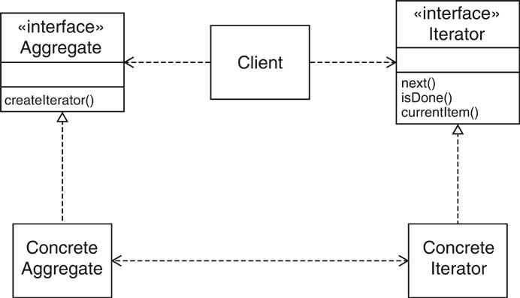
Iterator Pattern
Define an iterator that fetches one element at a time
Each iterator object keeps track of the position of the next element
If there are several aggregate/iterator variations, it is best if the aggregate and iterator classes realize common interface types.

Slide 35
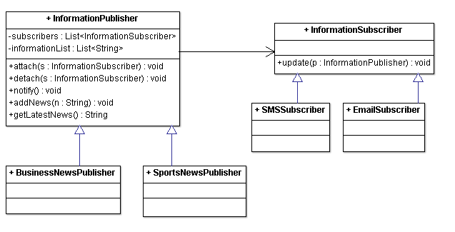
Observer Pattern Class Diagram
Subject which can be abstract class or interface
Concrete
observers
p.getLatestNews();
for(InformationSubscriber s : subscribers) {
o.update(this);
}

Slide 36
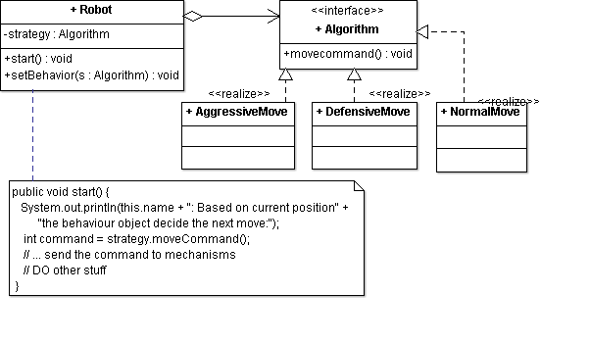
Strategy pattern class diagram
The Overall “Context”
Different concrete strategies (algorithms) to move the robot

Slide 37
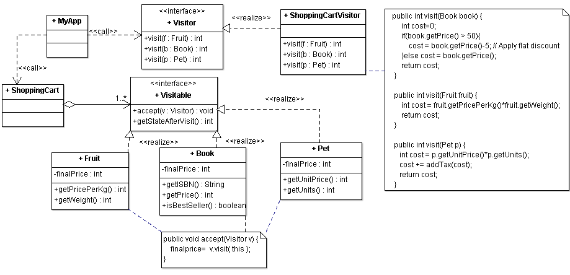
Visitor Pattern Class Diagram
declare the visit operations for all the types of concrete visitable classes
Implements a specific activity (price computation) for all visitables
This is ObjectStructure
Another class that is a collection of visitable objects
Offers mechanisms to iterate over visitable

Slide 38
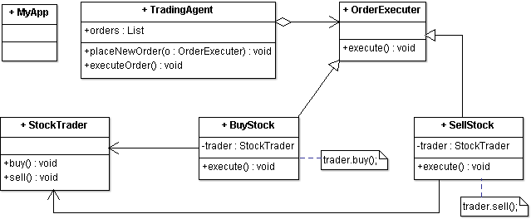
Command Pattern Class Diagram
The invoker who asks the command to carry out request
Abstract Command to execute an operation
Receiver who knows how to execute an operation
Concrete command, implements execute() by invoking appropriate operations on Receiver

Slide 39
Cloud Infrastructure
Hypervisor
Virtual machine
Memory Mgmt in Virtualized Env.
Thin layer of OS between VM and hardware
Offers recovery, check-pointing, live-migration
SW that simulates a machine environment and hosts an OS
Para-virtualization: OS must be modified for virtualized layer
Full-virtualization: OS is not aware of virtualization layer
VM page table maps target address to an address within VM.
This is converted to physical address by Hypervisor page table
Traditionally- Page table maps consumer application address to machine address or disk location

Slide 40
Data
NOSQL preferred
No complex join and relational database approach
Key-value pair
Dynamic database schema
HDFS – open source implementation is Hadoop
MongoDB- stored data as object using JSON format
Better choice for OLTP workload
Hbase- key value pair, , column oriented
used by Google to store page information

Slide 41
Quality of Service
Availability
Performance
Security
All components should be available: $\prod_{i=1}^{n}{p(i)}$
All components should be available: ∏_(𝑖=1)^𝑛▒〖𝑝(𝑖)〗
At least one should be available: $1−\prod_{i=1}^{n}{(1−p\left(i\right))}$
At least one should be available: 1−∏_(𝑖=1)^𝑛▒〖(1−𝑝(𝑖))〗
Use spare-copy, graceful degradation and active-redundancy tactics
Increase the VM capacity on-demand
Add additional VMs to divert the load
As an architect
Assess Application’s resource demand and projected resource usage
Predict the load and ask for more resource from the cloud resource manager
Information stealing: copy data from one tenant’s physical resource to another
VM escape: exploit VMM weakness to get into VM’s address space
Side channel attack: Monitor VM activity to get useful information
Denial of Service: One tenant grabs the entire physical resource

Slide 42
CAP Theorem
No distributed system can achieve all of the three
Consistency, Availability, Partition Tolerance
Choosing Availability Over Consistency
It will respond to all requests, potentially returning stale reads and accepting conflicting writes
Eventual Consistency
Nodes across partitions are allowed to be inconsistent- for some time- then it becomes consistent
Architect’s decision- Design challenge
No more than n% of data should be stale
It shouldn’t take more than t sec. to be consistent

Slide 43
Thank You

